Slide 1
electrical vehicle testing EV HUB MOTOR TESTING EV MOTOR TESTING

Slide 2
Principle
EV (Electrical Vehicle) works on basic principle of science that is conversion of energy .
Electrical energy converted into mechanical Energy
There is a motor used in the electrical system to carry out on this duty of conversion

Slide 3
ELECTRICAL VEHICLE TESTING
A twin roller arrangement is there.
The roller arrangement is connected with flywheel arrangements which provides suitable inertia load when performing acceleration ,max speed & brake test.

Slide 4
Two pneumatic cylinders guide vehicle lifts out platform .
Reed switch are used for sensing position of piston cylinder like UP /DOWN
Air pressure for cylinder required as per specifications (2 bar).System will not operative in case air pressure below set pressure
Front wheel clamping arrangement for that proximity switch are used for that sensing clamp /declamp
Air pressure should be set as per clamping force

Slide 5
Interlocks
Emergency stop: will stop test cycle
Zero speed Interlock: On/off operation will be happen at stand still of the roller
Over speed Interlock: max speed of roller
Power Failure: failure of electrical supply
Low air pressure : alarm is triggered in case of low pressure

Slide 6
TEST CYCLE
MAX SPEED TEST
REAR WHEEL SPEEDOMETER VERIFICATION TEST
ACCELERATION TEST
REAR WHEEL BRAKE FORCE TEST
REVERSE SPEED TEST
REVERSE BRAKE TEST

Slide 7
According to vehicle specifications limit for each parameters are available for verifying & passing vehicle
PASS/NOT PASS Result will be display on screen

Slide 8
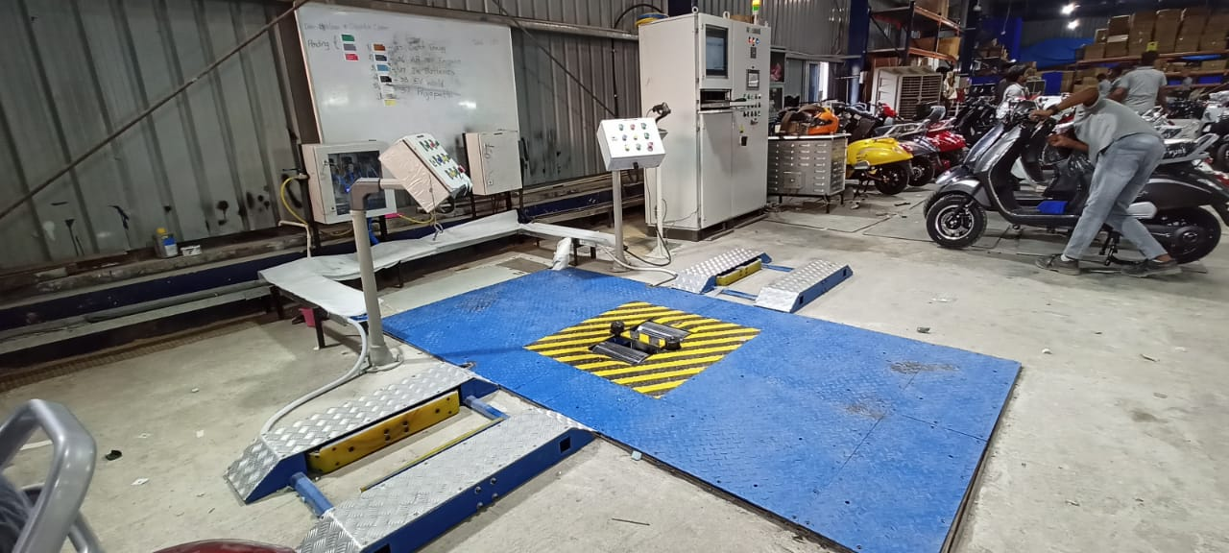

Slide 9
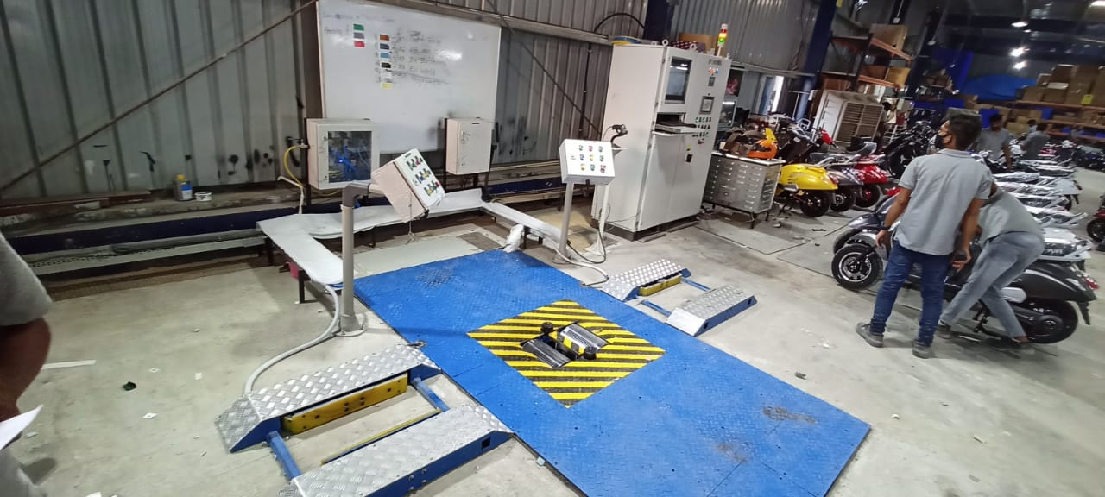

Slide 10
EV HUB MOTOR TESTING
FOR Hub motor testing below units are used
AC regenerative dynamometer
DC POWER Supply
DC controller
Power Analyser
Temperature sensors

Slide 11
PURPOSE
To monitor & display
motor electrical input power
Mechanical output power
Motor Efficiency
Input voltage ,current, power factor
Motor no load current ,full load current
No load ,full load torque
No load ,full load Speed
Motor temperature
Bearing temperature
Motor winding temperature
Motor electrical input power ,mechanical output power that is efficiency display on monitor & stored in tabular form & live graph

Slide 12
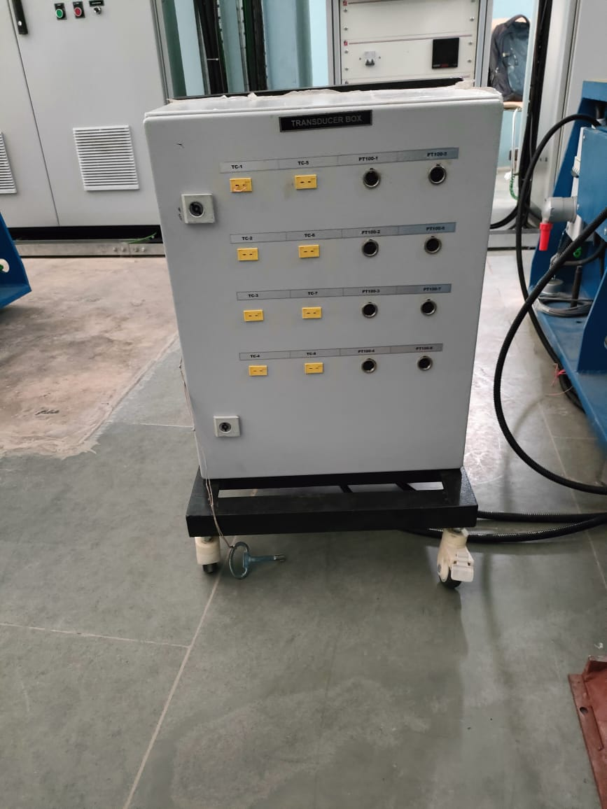

Slide 13
PC Screen
PC auto & manual mode selector soft push button switch on monitor screen .
Auto mode :
Data is capture on predefined time & torque ,speed points loading in 100 steps
Manual Mode:
Data is capture manually by pressing buttons on screen
Capture data is exported to MS Excel IN TABLE forms & in graphs to show torque –speed, speed-current, torque current characteristics, Efficiency Characteristics
Torque speed variations at different temperatures

Slide 14
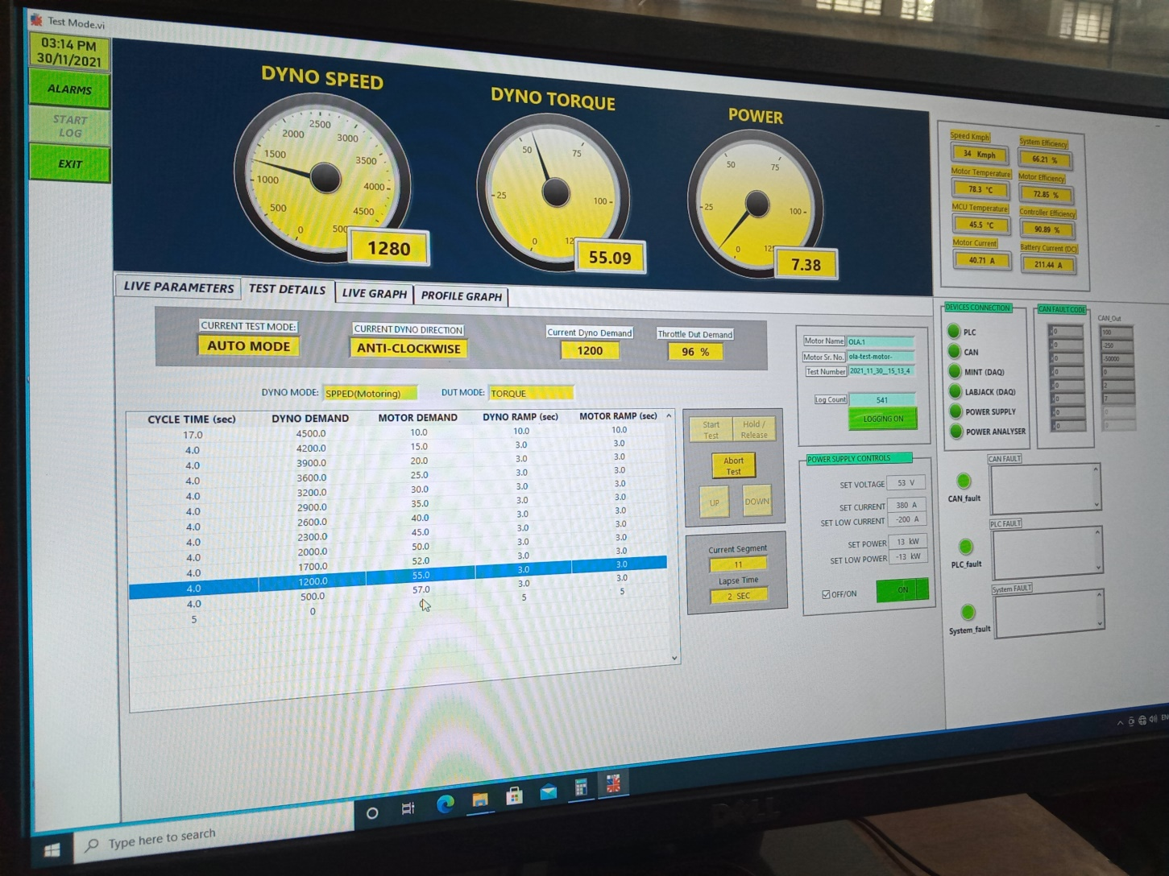

Slide 15
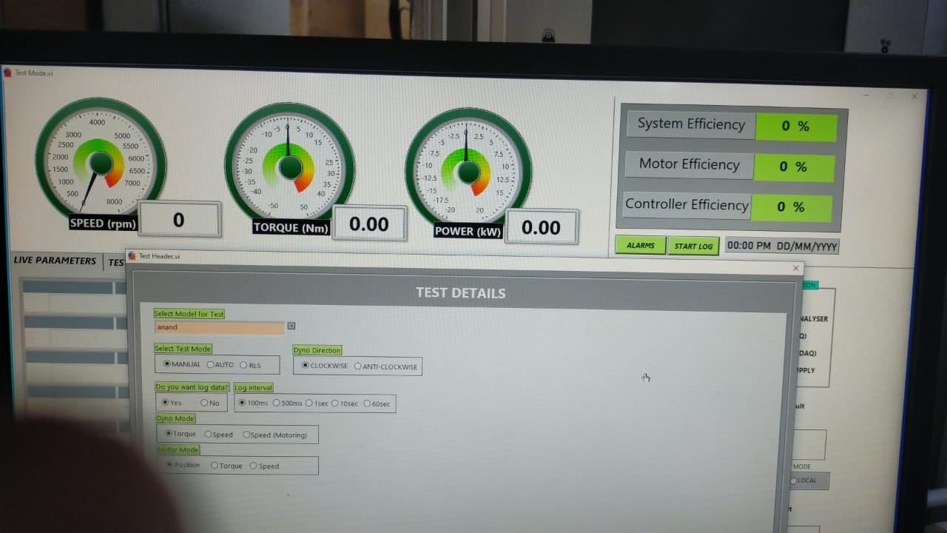

Slide 16
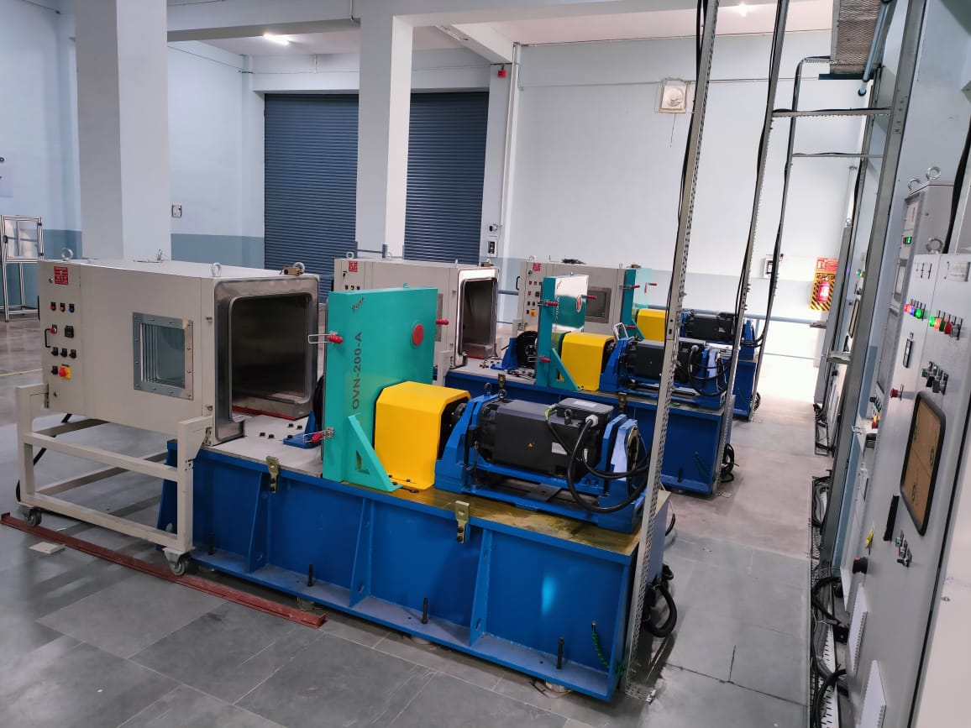

Slide 17
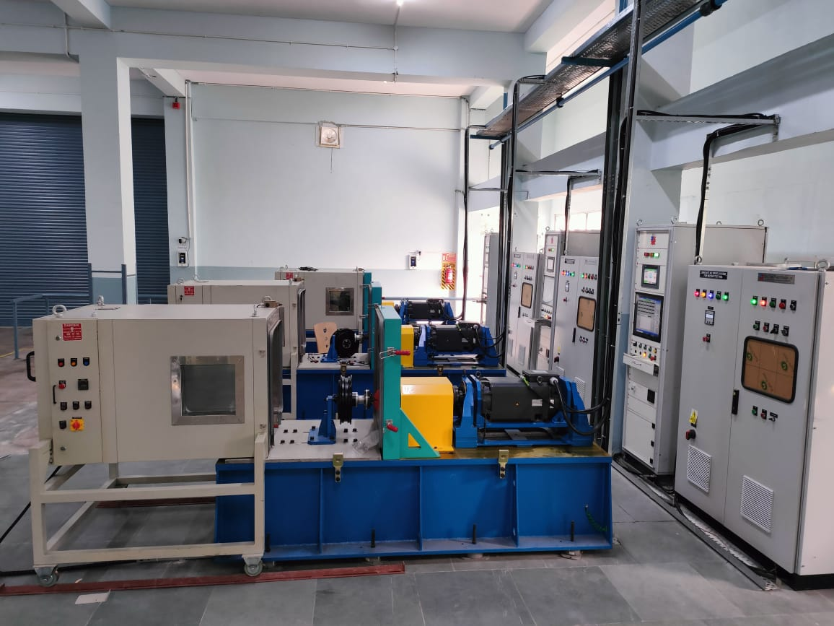

Slide 18
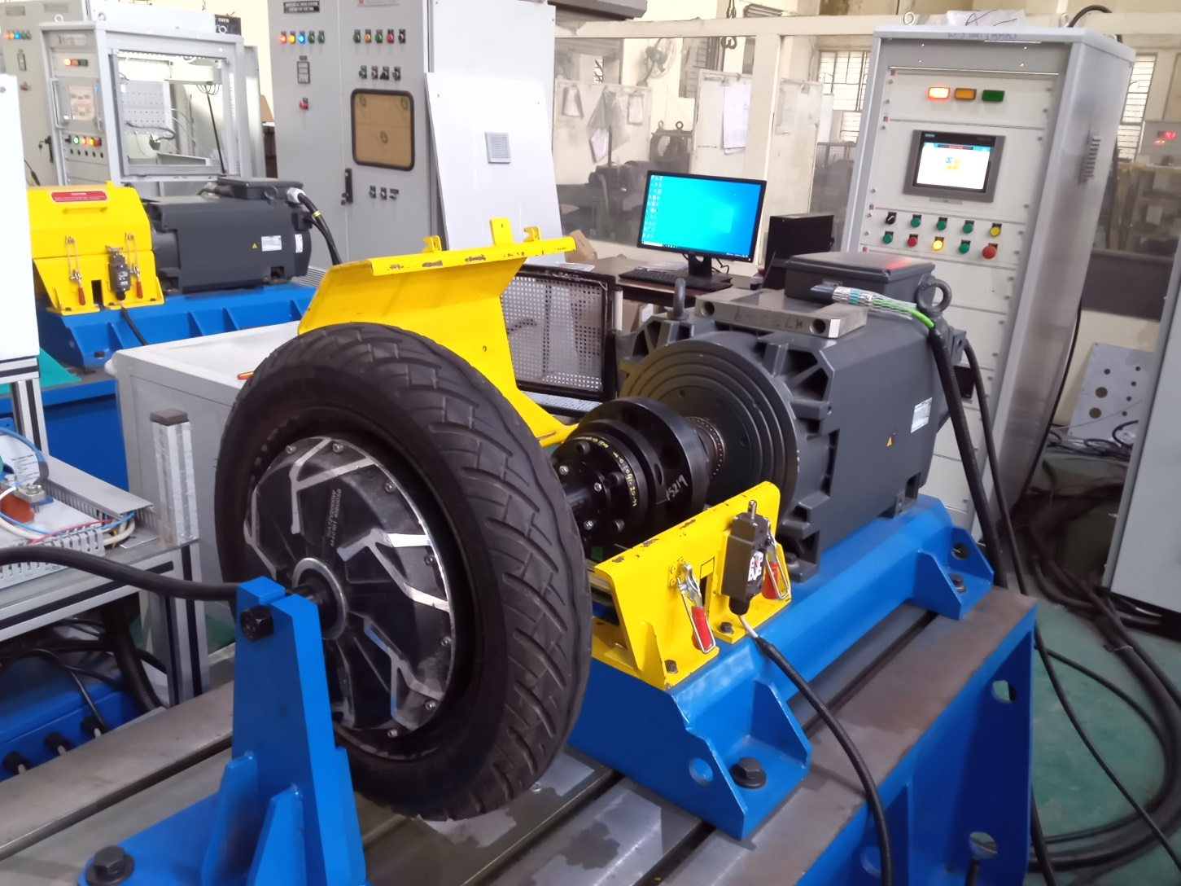

Slide 19
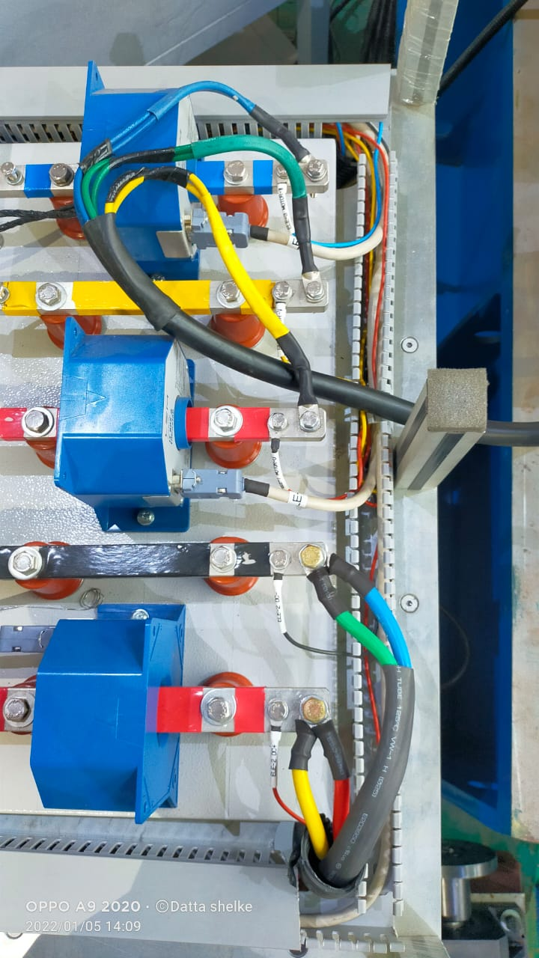

Slide 20
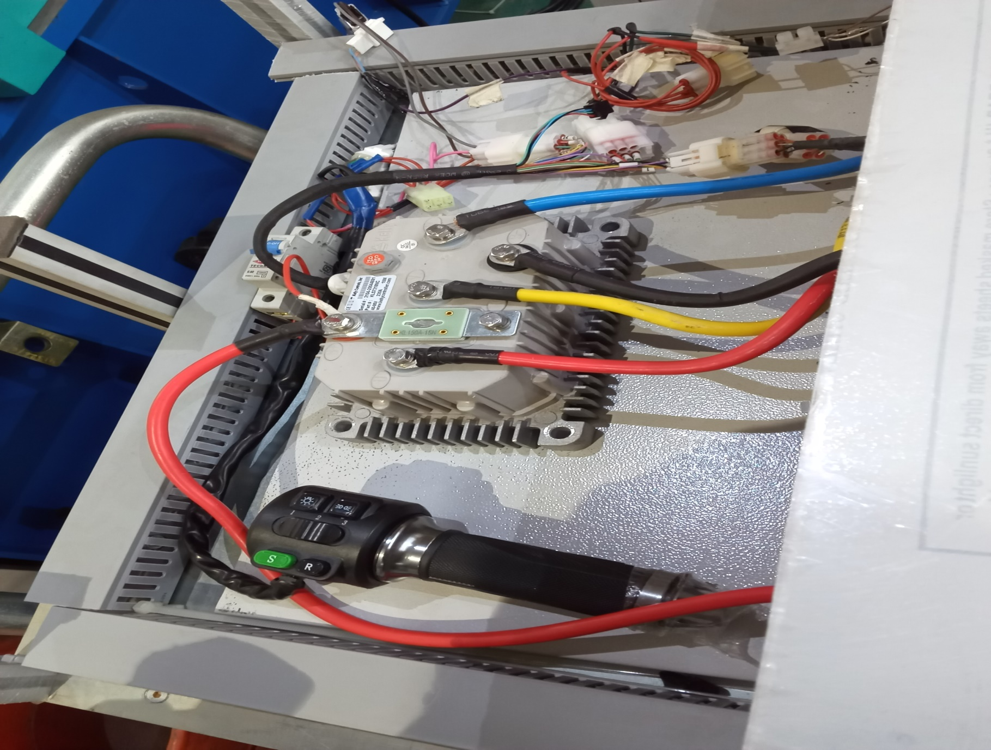

Slide 21
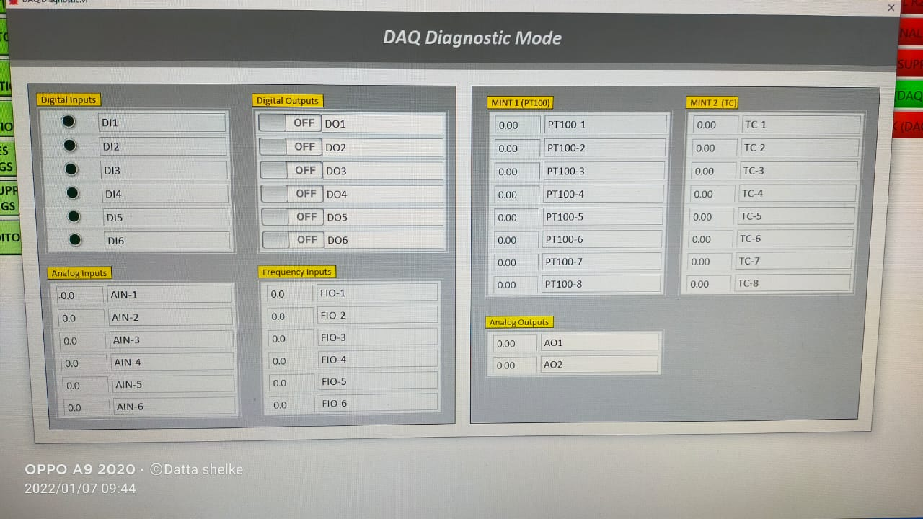

Slide 22
